Slide 1
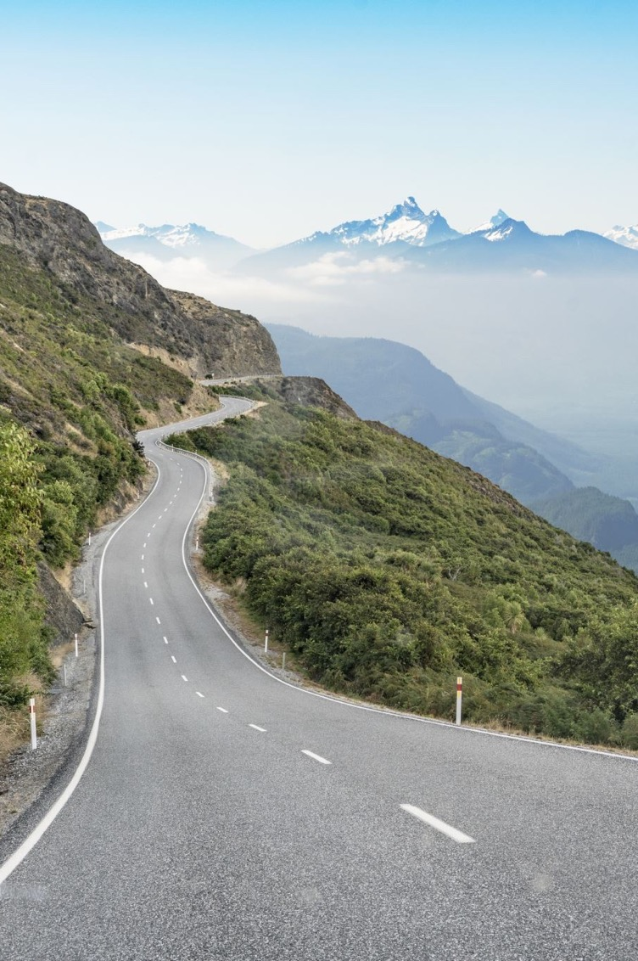
Using BiotaPhy to Investigate Biodiversity Of Alpine Ecosystems
Hector Fox Botany Workshops Summer 2021

Slide 2
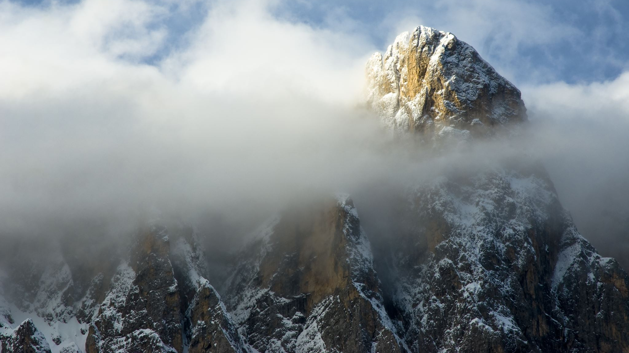
Mountains Matter for Biodiversity

Slide 3

Mountains are Disproportionally Diverse
Rahbek et al. (2019) Science

Slide 4
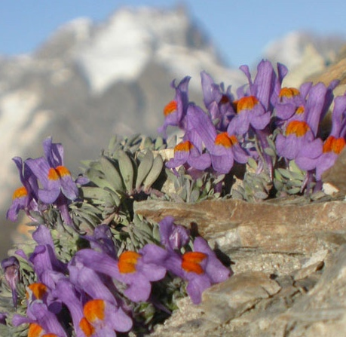
The Alpine Ecosystem
Life at the edge of terrestrial area.
High elevation, treeless habitat.
Often at plant’s physiological limits.
Freezing weather & large temp. fluctuations.
Changes in pressure & precipitation.
Harsh soil conditions and erosion.
Much less known about alpine ecosystems.
Linaria alpina (alpine toadflax; Lamiales); ~2600 m; French Alps.
Streb et al. 2021; Körner 2003

Slide 5
Project Goals
Chose to investigate changes in composition and diversity of alpine communities…
…across the American mountain range system.
Connect observed distributional patterns to underlying ecological and evolutionary processes…
…e.g., abiotic filtering, niche conservatism, biogeographical history, and ecological dynamics.
Global mountain biodiversity assessment (GMBA), 2010.

Slide 6

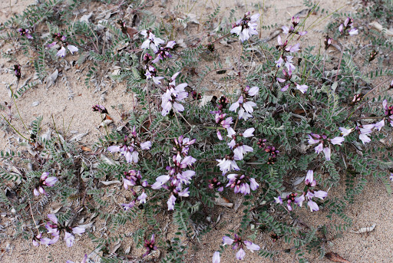
Niche Model Dataset
Astragalus alpinus
Curated dataset of 72,000+ seed plant species.
Detailed descriptions of their temp., prec., and elevational niches.
Integrated with phylogenetic information.
Soltis & Soltis 2016; Grady et al., in prep; Figueroa et al., in review.

Slide 7
Some Key Results

Slide 8
Alpine Species Richness
Two biodiversity “hotspots”.
North America
Central Andes.
Departs from “expected” latitudinal diversity gradient (LDG) often observed.
Recent global analysis of alpine communities (Testolin et al. 2021, GEB) showed a more traditional LDG.
It is possible this pattern is thus unique to the Americas.
Biology or undersampling?
Figueroa et al. (2021) Alpine Botany

Slide 9
Biodiversity Metrics
Species Diversity (richness) is only one component of community biodiversity.
Phylogenetic Diversity (PD) is another pillar.
PD represents the total evolutionary history circumscribed by the species in a particular community.
Can say something about the evolutionary history of assemblages.
Functional Diversity results coming in future projects!
Swenson (2011) Amer. J. Botany

Slide 10
Phylogenetic Diversity
PDI > 0: species less related than expected by chance (Phylogenetically Overdispersed).
PDI < 0: species more related than expected by chance (Phylogenetically Clustered).
Figueroa et al. (2021) Alpine Botany

Slide 11
Phylogenetic Diversity
Northern Rockies/ Alaska:
Phylogenetically clustered specialists.
Southern Andes:
Phylogenetically overdispersed generalists.
These locations have broadly similar macro-scale climate conditions.
Abiotic filtering would therefore predict similar composition.
Suggests a role for historical factors.
Figueroa et al. (2021) Alpine Botany

Slide 12
Main Takeaways & Conclusions
Alpine dataset provides an excellent resource to assess the extent and quality of the current state of knowledge on alpine plant distributions.
American alpine communities show unique and interesting biodiversity patterns across the mountain range system.
The complex and scale-dependent distributional patterns suggest roles for both abiotic filtering and biogeographic history in understanding where contemporary species are found.
Figueroa et al. (2021) Alpine Botany

Slide 13


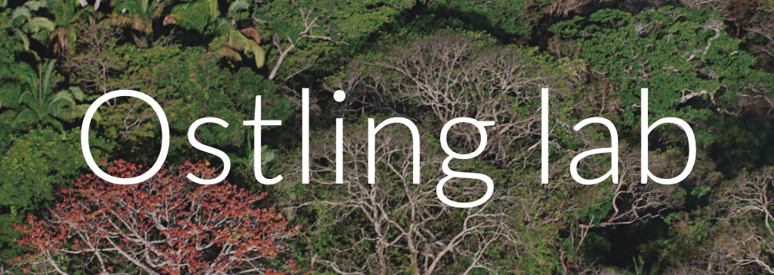
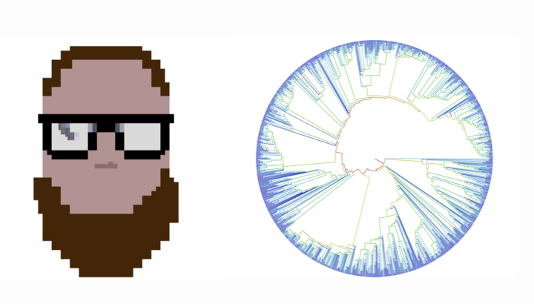




“Our whole lives are just stories”
Ursula Trigos
Will Weaver
Tamara Milton
Annette Ostling
Dylan DeBaun
Yingying Yang
CW Dick
Sarah Orth
Andrew Marshall
Hannah Marx
Keyi Feng
Miao Sun
Jacob Berv
Douglas Soltis
Stephen A. Smith
Drew Larson
Minh Chau Ho
CJ Grady
Pamela Soltis
Nicholas J. Engle-Wrye
Jim Beach
Maria Beatriz de Souza Cortez
Aimee Stewart
Deise Gonçalves
Ryan A. Folk

Slide 14

THANKS!

